Slide 1

An Analysis of Liam’s Pizza-eating Activities
Group 4
Marianna, Rosemary, Rosana, Shaday, Marilyn

Slide 2
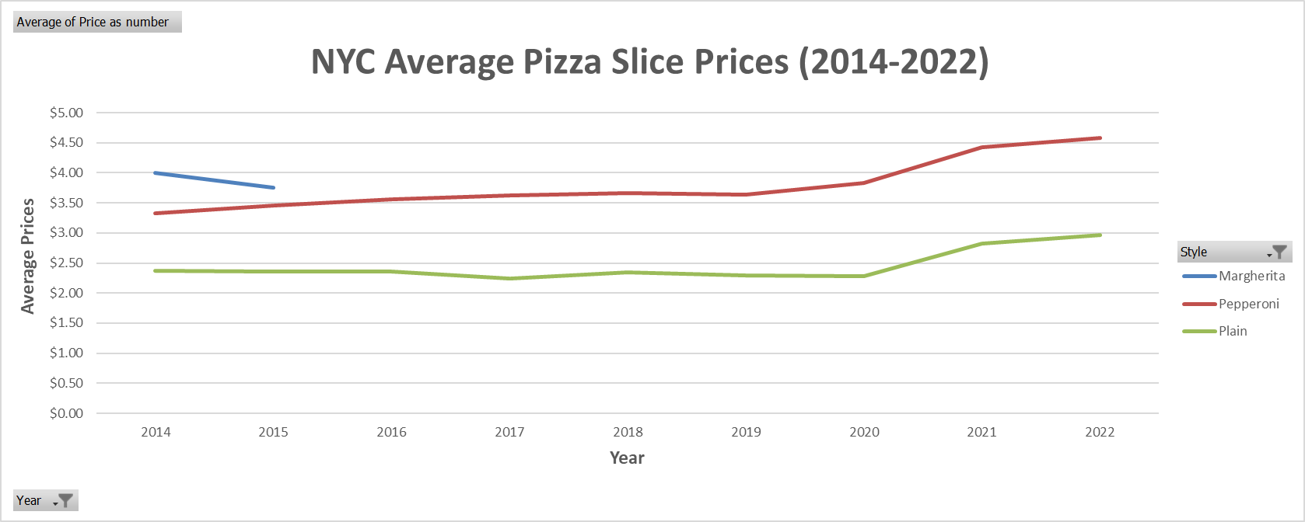
Question: How has the average price of pizza changed over the years?

Slide 3
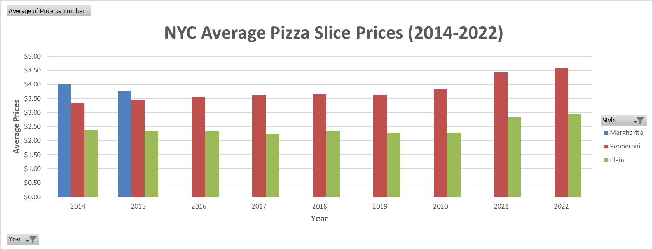
Question: How has the average price of pizza changed over the years?

Slide 4

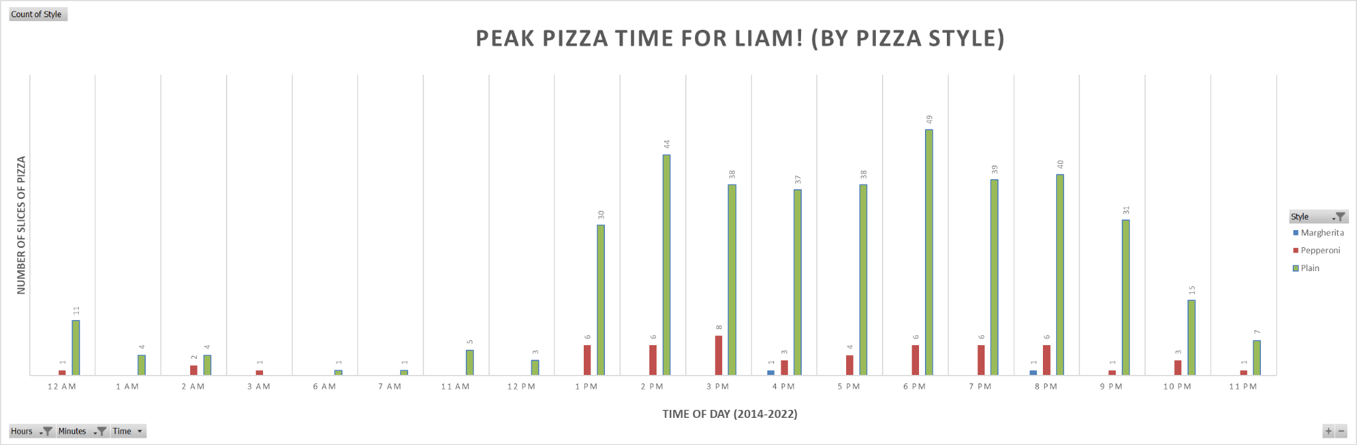
Question: What hours of the day are “peak pizza time” for Liam?

Slide 5
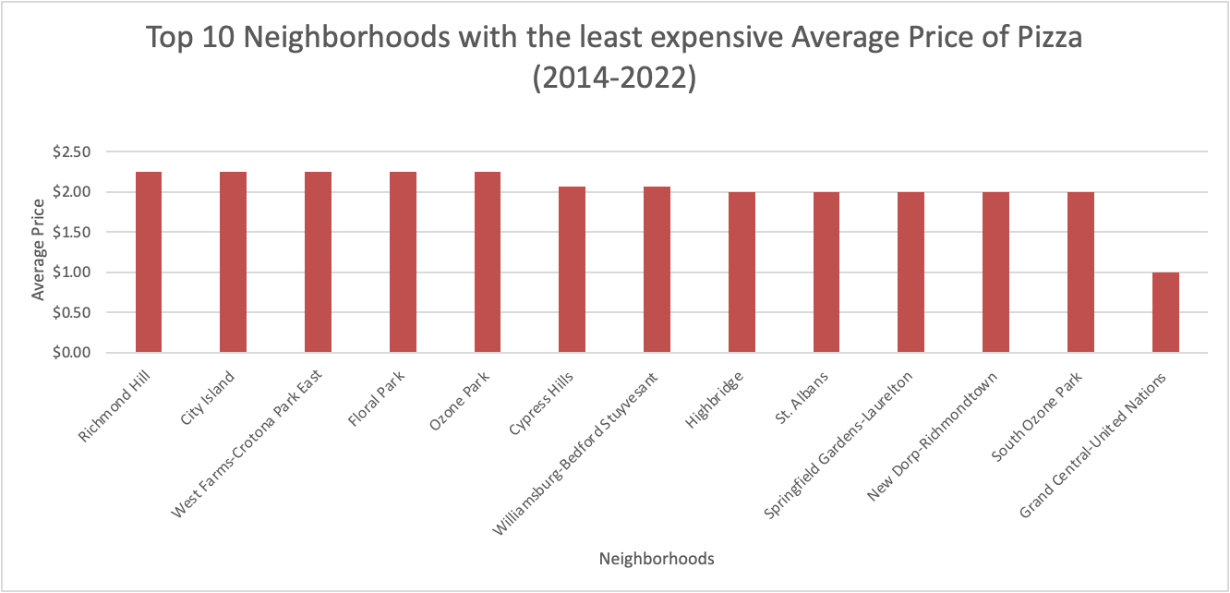
Question: Which neighborhood has the least expensive pizza?

Slide 6
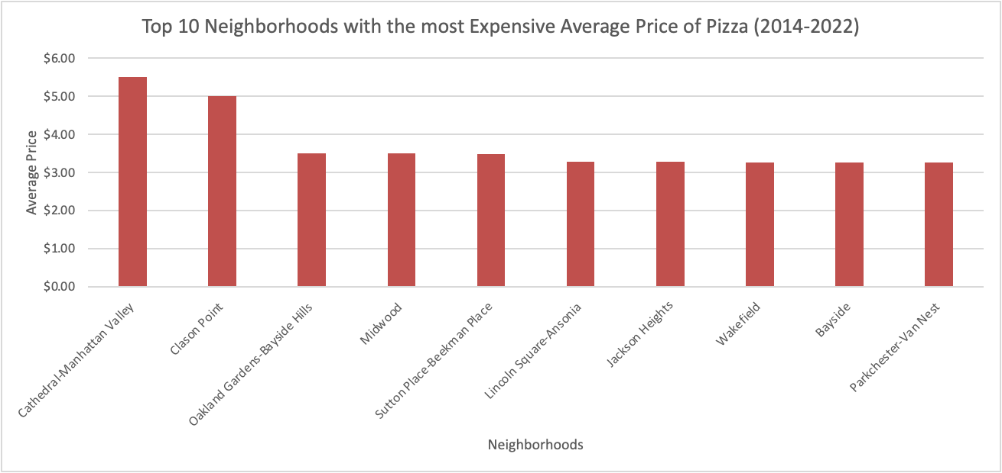
Question: Which neighborhood has the most expensive pizza?

Slide 7
